Slide 1


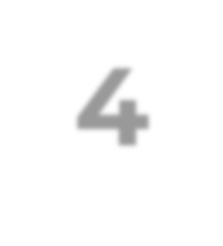

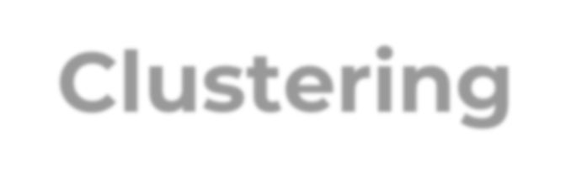
Capstone Project-4
Presentation on
Netflix Movies and TV Shows Clustering
Presented By:- Ajit Padole.

Slide 2

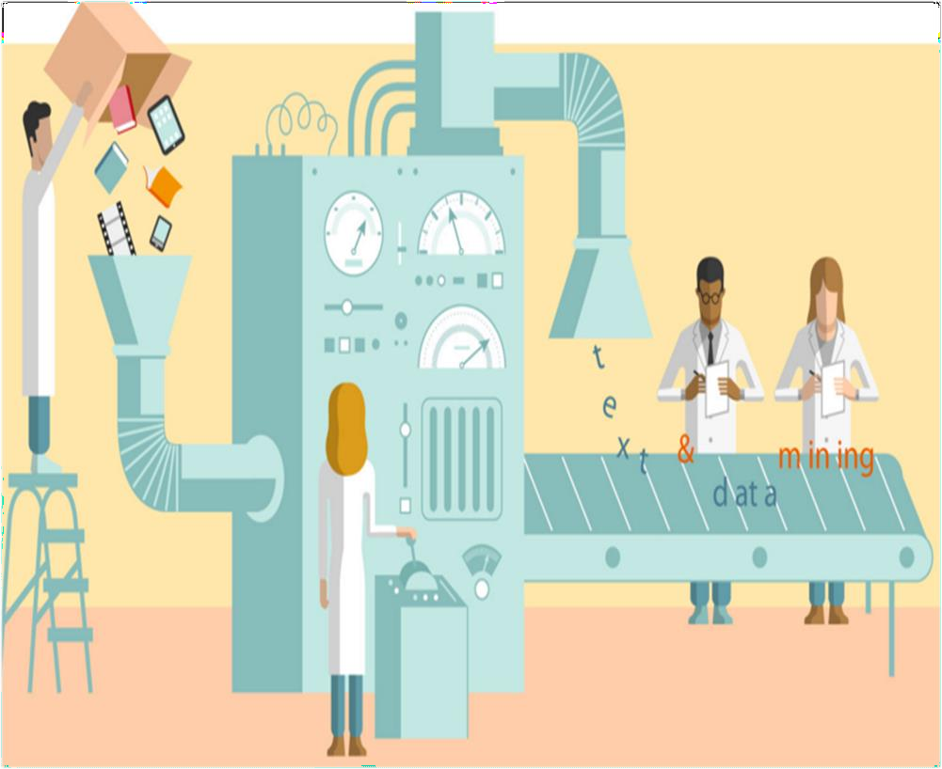
Agenda
Defining Problem Statement
Data Pipeline
Data Summary
EDA
Applying Model Clustering
Conclusion

Slide 3
Problem Statement
Netflix has become the dominant company in the on-demand media industry, with 167 million paying subscribers around the world.
We have been provided a dataset collected from Flexible which is a third-party Netflix search engine.
Our job is to: -
To perform Exploratory Data Analysis
Understanding what type of content is available in different countries
Is Netflix increasingly focused on TV rather than movies in recent years.
Clustering similar content by matching text-based features

Slide 4

Data pipeline
Data Pre-processing: After exploring and understanding our data, we did data cleaning by handling Null/missing values, and checking for duplicate values. We further changed the “date_added” variable to its appropriate DateTime format and created a new variable “year_added” by extracting year from it.
EDA: We performed an exploratory analysis of data and find useful insights.
Creating a model: After identifying useful features, we performed text cleaning- by removing stopwords, and punctuation and doing stemming of words. After calculating clean text lengths, we standardize those values and applied two clustering algorithms- K-means and HAC (Hierarchal Agglomerative Clustering).

Slide 5

Data summary
show_id : Unique ID for every Movie / Tv Show
type : Shows it is a Movie or TV Show
title : Gives title of the Movie / Tv Show
director : Director of the Movie
cast : Actors involved in the movie / show
country : Country where the movie / show was produced
date_added : Date it was added on Netflix
release_year : Actual Release year of the movie / show
rating : TV Rating of the movie / show
duration : Total Duration - in minutes or number of seasons
listed_in : Genre of Movies and TV Shows
description: The Summary description of movies and TV shows

Slide 6
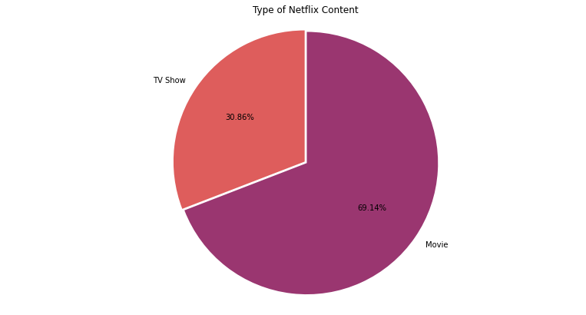
Exploratory Data Analysis
Share of TV Show and Movie in dataset
Clearly number of Movies on Netflix outnumbered the number of TV Shows.
Almost 70% content are movies while rest 30% are TV Shows.

Slide 7
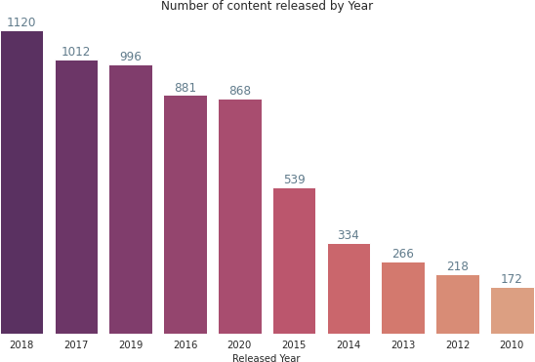
Exploratory Data Analysis
Distribution of number of content released per year
As per the contents available on Netflix, most of them are from recent years – i.e 2018,2017 and 2019.
The trend shows that as we go from year 2010 to 2018, the number of contents on the basis of respective year release increases.

Slide 8
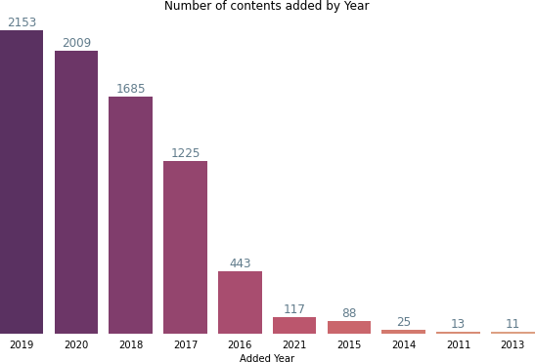
Exploratory Data Analysis
Distribution of content added on Netflix by year
Clearly, we can see the number of contents on the platform is increasing year on year.
There is drastic increase in 2016-2017, this is probably Netflix was launched in India this year. and to attract Indian viewers it started adding Indian contents as well.

Slide 9
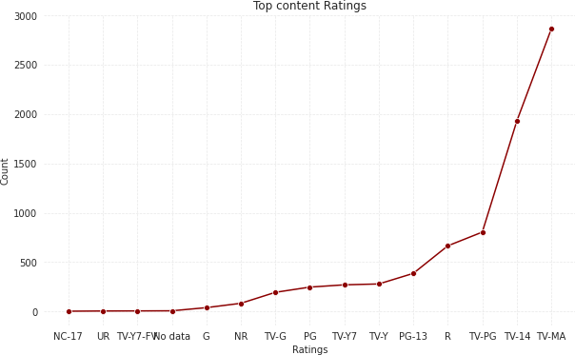
Exploratory Data Analysis
Distribution of ratings of content added on Netflix
The plot shows with a rating of TV-MA are in the clear majority. This is followed by TV-14.
These top two ratings have way too much numbers of contents compared to other ratings.

Slide 10
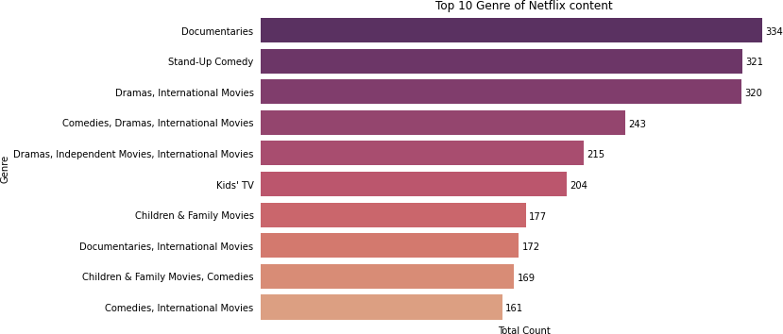
Exploratory Data Analysis
Top content genre available in Netflix

Slide 11
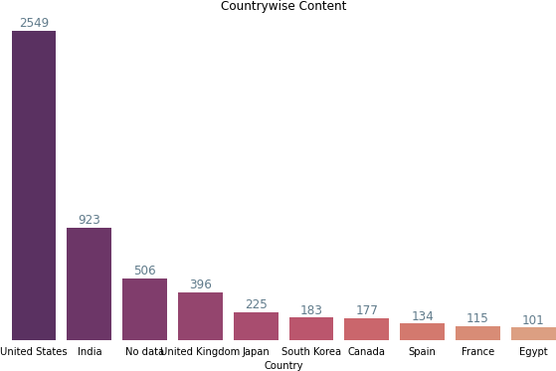
Exploratory Data Analysis
Top content producing countries
The United States account for the majority of the content created on Netflix, numbering 2549 titles.
India is the second
largest with 923 titles.

Slide 12
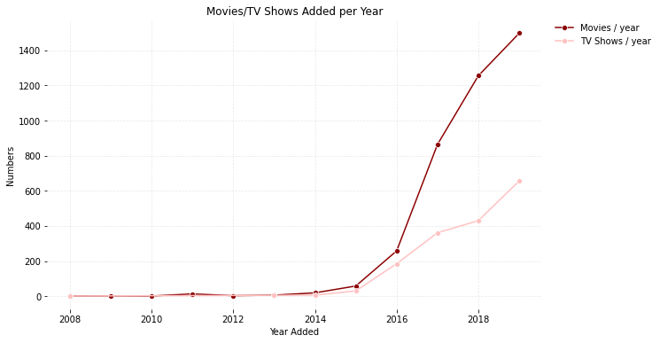
Exploratory Data Analysis
Content added on Netflix per year
As can be seen in this plot, both TV shows and Movies content numbers increased drastically after 2016.
Also the number of movies added were much higher compared to TV shows number.

Slide 13
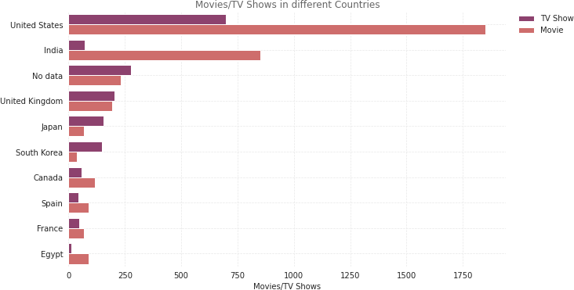
Exploratory Data Analysis
Distribution of Movies/TV Shows produced in various countries
The United States accounts for the majority of the content created on Netflix.
India is the second largest.
In both countries, number of movies outnumbers the number of shows.

Slide 14
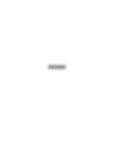
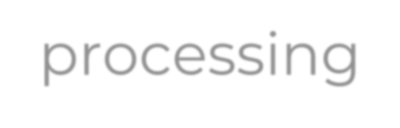

Data Pre-processing
We cannot go straight from raw text to fitting a machine learning model. We must
clean text first, which means splitting it into words and handling punctuation.
For clustering we choose “description” and “Listed_in” variables. Before clustering we
need to pre-process the data. So that we filtered data with following steps:
Text Example: “After an awful accident, a couple admitted to a grisly hospital are separated and must find each other to escape
before death finds them.”
1. Remove Punctuation |  | 2. Remove Stop-words
Text after removing punctuations: After an awful accident a couple admitted to a grisly hospital are separated and must find each other to escape — before death finds them. |  | Text after removing stopwords: awful accident couple admitted grisly hospital separated must find escape — death finds
3. Stemming |  | 4. Length of processed text
Text after removing stopwords: aw accid coupl admit grisli hospit separ must find escap — death find |  | Calculate the length of text we got from first three steps to do clustering
escape — before
death finds them

Slide 15

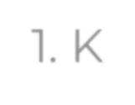

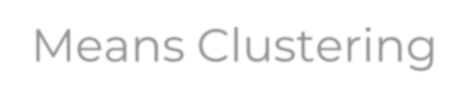
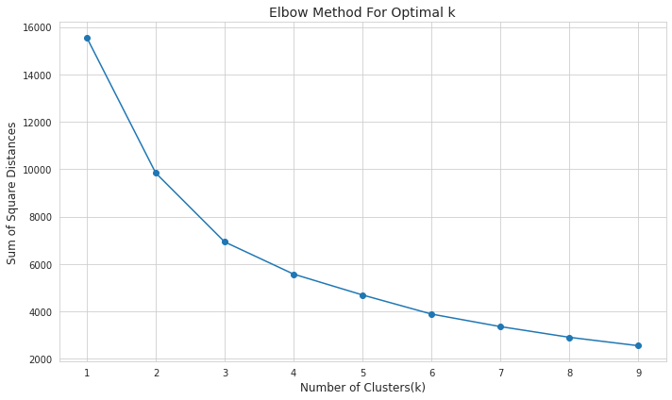

Applying Model
The K-Means algorithm
searches for a predetermined number of clusters within an
1. K-Means Clustering
unlabelled multidimensional dataset.
The Elbow Method is one of the most popular methods to determine this optimal value of k number of clusters.
To determine the optimal number of clusters, we have to select the value of k at the “elbow” i.e. the point after which the distortion/inertia start decreasing in a linear fashion.
Thus from this chart we need to check, which would be the best number of clusters from 2,3,4,5, and 7.
We found elbow formation at k=3.

Slide 16
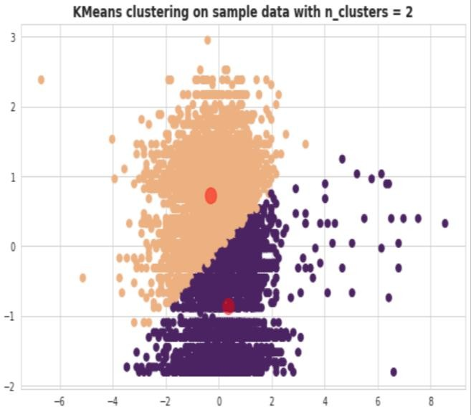
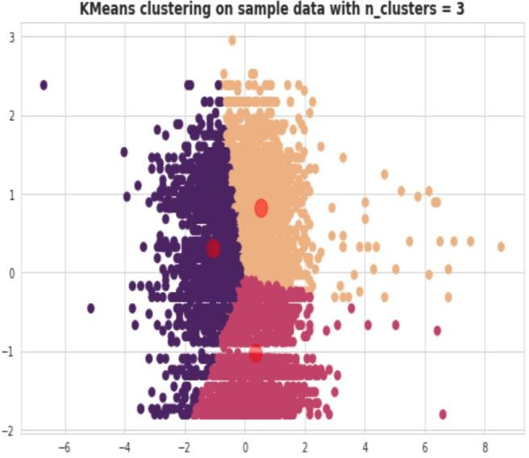
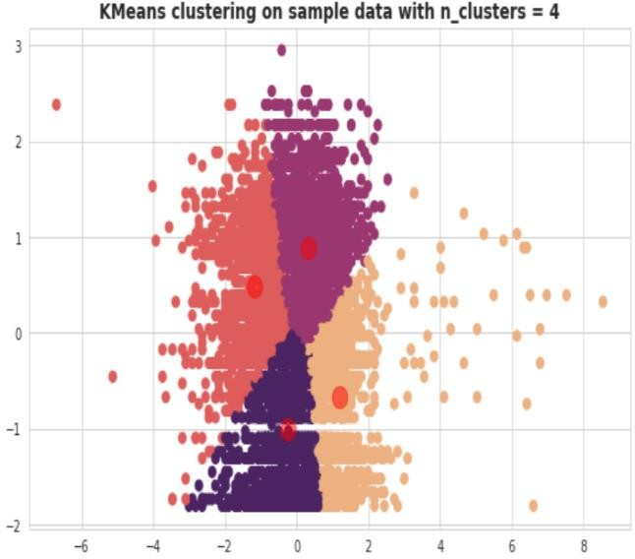
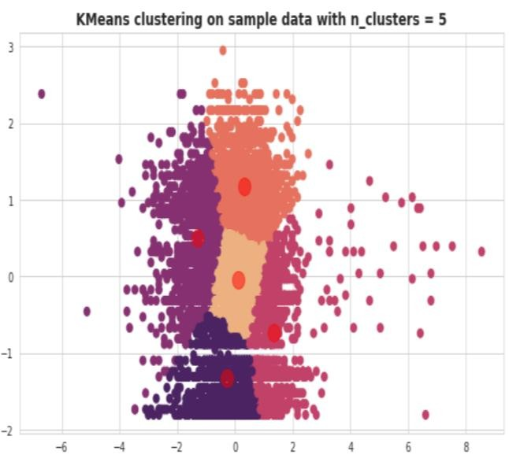
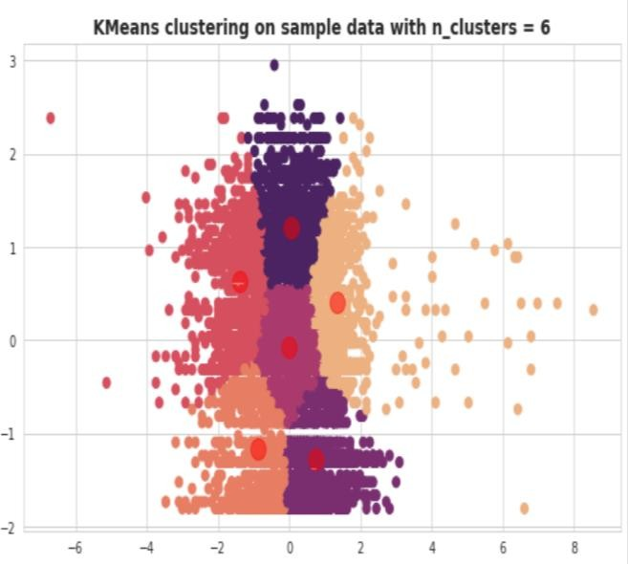
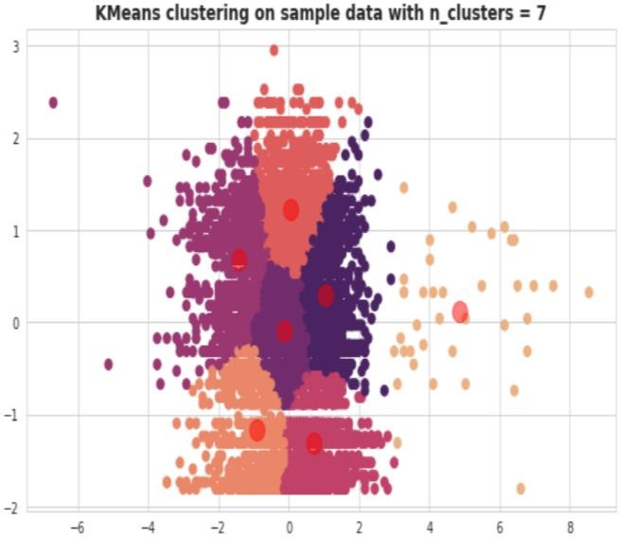
Applying Model
Different clusters to check optimum number of clusters

Slide 17
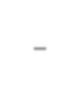

Silhouette Score for K-Means
Let's see the Silhouette scores of 2,3,4,5,6,7 and 8 number of clusters
Silhouette score is used to evaluate the
quality of clusters created using
For n_clusters = 2, silhouette score is 0.3551415129079424
clustering algorithms such as K-Means in terms of how well
●
For n_clusters = 3, silhouette score is 0.35589698124108055
For n_clusters = 4, silhouette score is 0.3266968907071311
For n_clusters = 5, silhouette score is 0.33558430881056384
For n_clusters = 6, silhouette score is 0.3557380959007992
For n_clusters = 7, silhouette score is 0.3548817152999796
For n_clusters = 8, silhouette score is 0.3522803075712804
samples are clustered
with other samples that are similar to each other.
The Silhouette score
is calculated for each sample of different clusters.

Slide 18

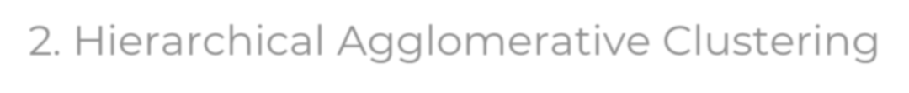
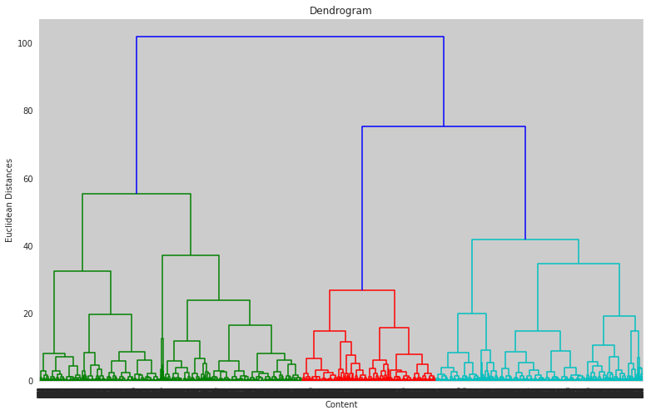
Applying Model
Hierarchical
Agglomerative clustering
2. Hierarchical Agglomerative Clustering
starts with treating each
observation as an individual cluster, and then iteratively merges clusters until all the data points are merged into a single cluster.
Dendrograms are used to represent hierarchical clustering results.
The number of appropriate clusters will be the number of vertical lines which are being intersected by the line drawn using the threshold in this case – 3.

Slide 19
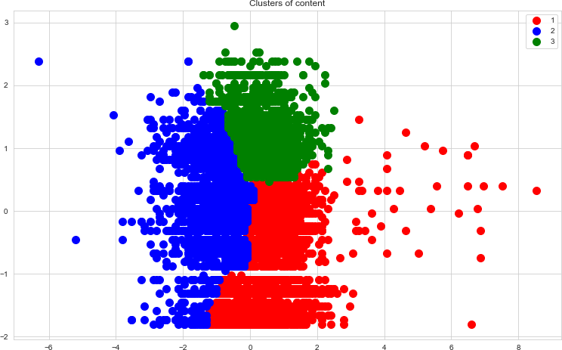
Hierarchical Agglomerative Clustering

Slide 20

Conclusion
We started this project with the intention to obtain some useful insights related to the type of Netflix content. For this, we performed exploratory data analysis on our data after cleaning and making it easy to analyze. This analysis helped us to understand the trend .
We found that most of the content on Netflix are of TV-MA and TV-14 rating.
USA and India are two countries producing the maximum number of content.
Documentaries and Stand up are top genre in terms of number of contents they have on platform. Further we found number of movies on Netflix outnumbers TV-shows.
Our next job was to make an unsupervised clustering model. For this, we processed our text by removing unuseful characters like - stopwords, punctuation and did stemming. After getting the length for each text feature we rescaled them for generalization and started applying algorithms.
We first used K-means clustering. In order to find appropriate cluster number we used elbow method and finally got the best silhouette score of around 0.35. Next, we applied Hierarchal Agglomerative Clustering for which we made dendrogram. We also obtained silhouette score of around 0.32.

Slide 21
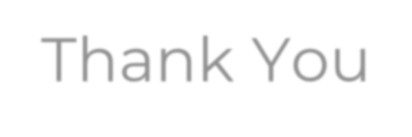
Thank You

